Slide 1
WEEK 1 · AZURE FOR CAREER CHANGERS
Cloud & Azure
Fundamentals
Your first week in the cloud — no IT background required.
8 topics · from cloud basics to the Azure Portal
Notes:
Welcome everyone to Week 1 of Azure for Career Changers. Set the tone: no IT-infrastructure background is needed, and we'll lean on everyday analogies throughout. Today is a guided tour across eight foundational topics, from what the cloud actually is all the way to clicking around the Azure Portal. Reassure them the goal is confidence with the vocabulary and the mental models, not memorizing every detail. If anyone wants the exam context, this maps to Microsoft's AZ-900 Azure Fundamentals certification.
Useful links
Azure Fundamentals (AZ-900) certification: https://learn.microsoft.com/credentials/certifications/azure-fundamentals/
AZ-900 study guide: https://learn.microsoft.com/credentials/certifications/resources/study-guides/az-900
Create a free Azure account: https://azure.microsoft.com/free/

Slide 2
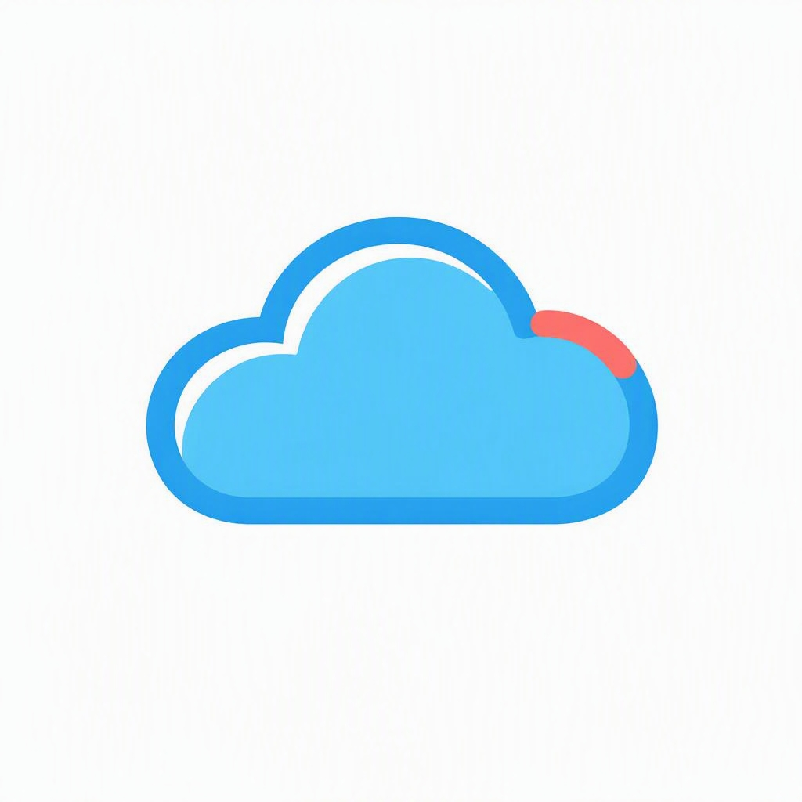
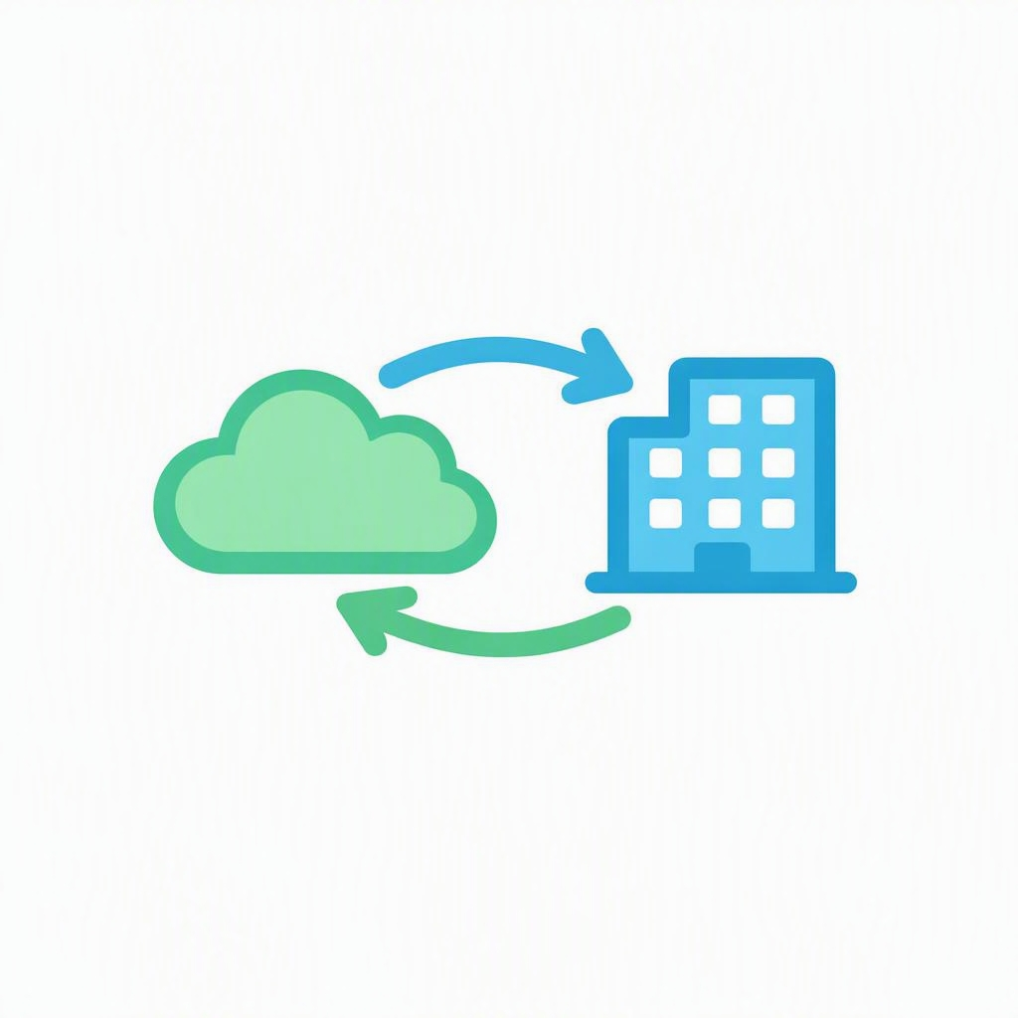
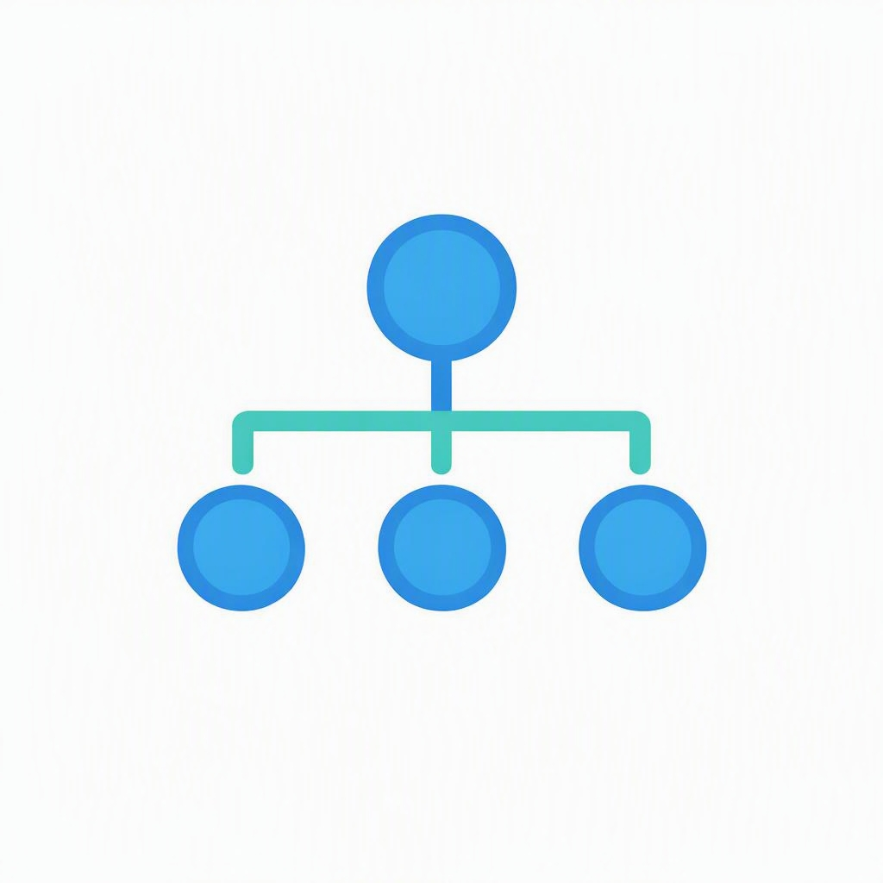
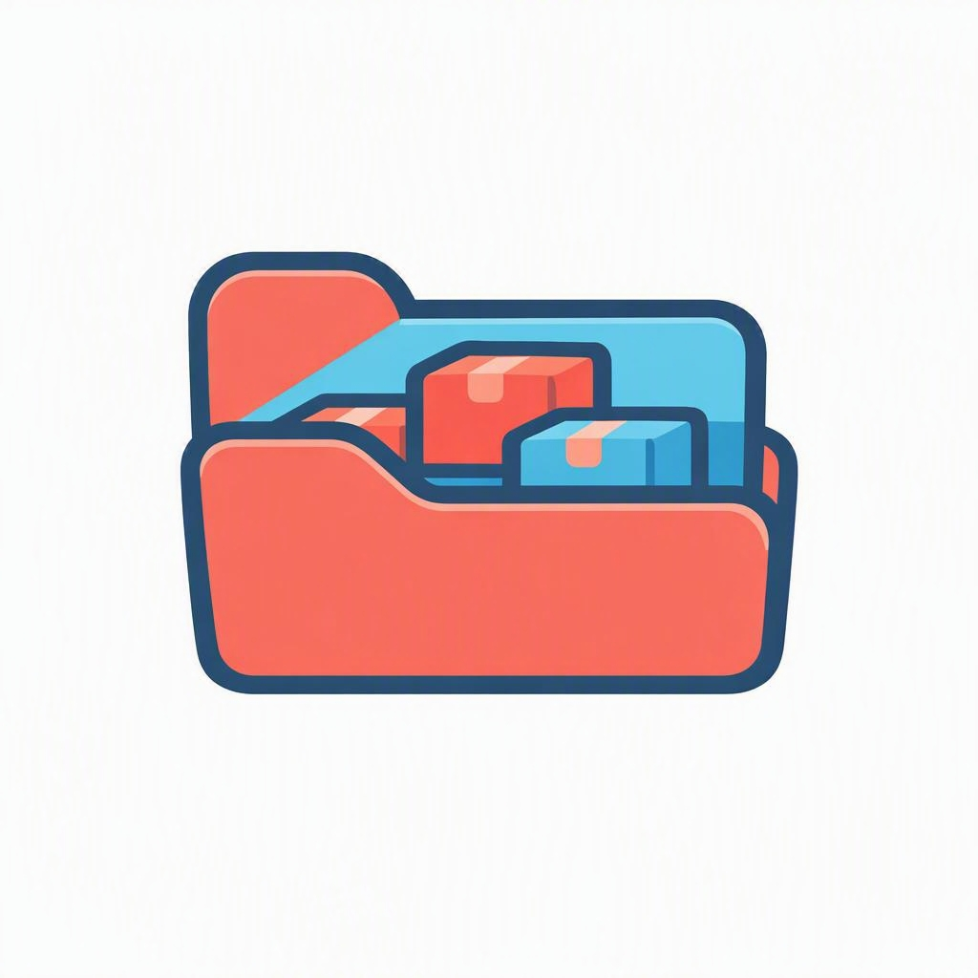
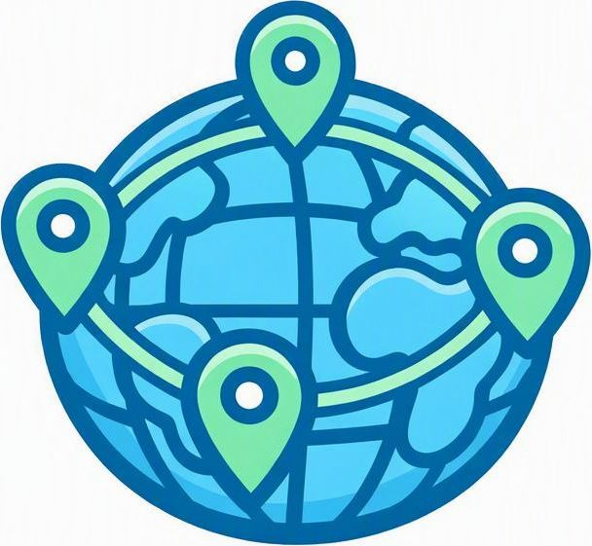
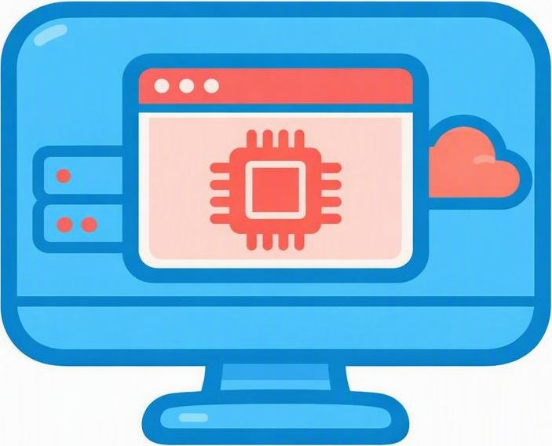
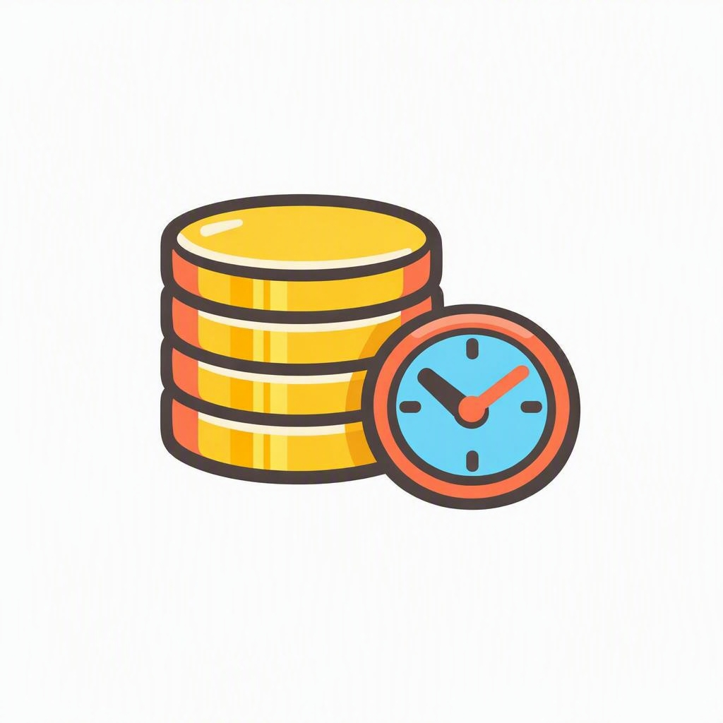

Your roadmap for the week
WEEK 1 AT A GLANCE
01
02
03
04
Cloud computing concepts
Public, private & hybrid
Azure architecture basics
Resource Groups
05
06
07
08
Regions & Availability Zones
Compute fundamentals
Cloud cost concepts
Azure Portal navigation
Notes:
Here's our roadmap for the week. Walk the class through the eight topics and point out that they build on each other: we start with what cloud computing is, move through deployment models and Azure's structure, then get into where things run and what they cost, and finish hands-on in the Portal. Tell them not to worry if a term is unfamiliar now — each one gets its own slide. The free AZ-900 learning path on Microsoft Learn mirrors this sequence if they want to self-study between sessions.
Useful links
Azure Fundamentals learning path (Microsoft Learn): https://learn.microsoft.com/training/paths/microsoft-azure-fundamentals-describe-cloud-concepts/

Slide 3
Cloud Foundations
01
PART 01
What is cloud
Why it matters
Service & deployment models
Notes:
This first part builds the core mental model. We'll define what the cloud actually is, why organizations are moving to it, and the two ways we slice it up — service models (IaaS, PaaS, SaaS) and, in the next part, deployment models. Keep it conceptual here; the concrete Azure services come later.

Slide 4

What is cloud computing?
CLOUD COMPUTING CONCEPTS
Cloud computing means renting computing power — servers, storage, databases, networking and software — over the internet, and paying only for what you use.
On-demand — spin resources up in minutes
Pay-as-you-go — no big upfront purchase
Reachable from anywhere over the internet
Maintained by the cloud provider, not you
IN PLAIN TERMS
Like electricity: flip a switch and pay for the power you use — you don't build your own power plant.
Notes:
Anchor the definition: the cloud is renting computing — servers, storage, databases, networking, software — over the internet, and paying only for what you use. Hit the four traits on the left: on-demand, pay-as-you-go, reachable from anywhere, and maintained by the provider. Lean on the electricity analogy: you don't build a power plant to run a lamp; you flip a switch and pay for what you draw.
Useful links
What is cloud computing? (Azure): https://azure.microsoft.com/resources/cloud-computing-dictionary/what-is-cloud-computing/

Slide 5

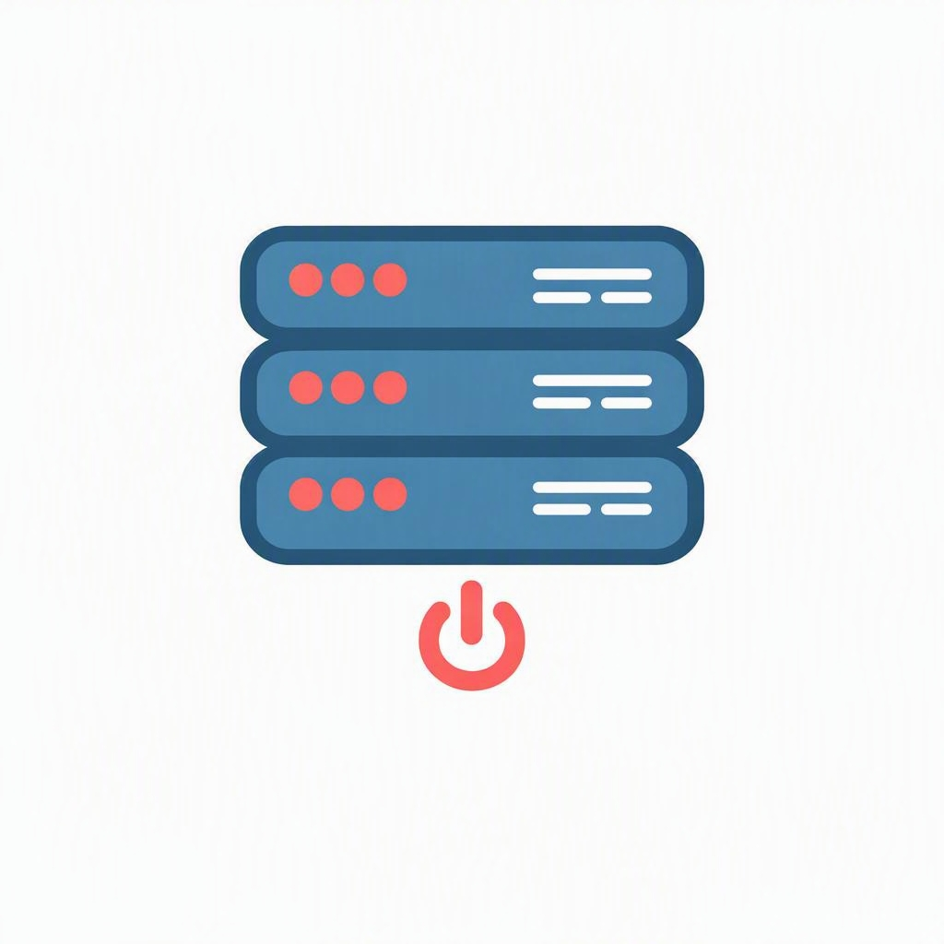
Four reasons the cloud wins
WHY ORGANIZATIONS MOVE TO THE CLOUD
Scale on demand
Pay only for use
Global reach
No hardware to run
Add or remove capacity in minutes as needs change.
Turn a big upfront cost into a flexible monthly bill.
Deploy close to users across the world in a few clicks.
The provider owns and maintains the physical gear.
Notes:
Four reasons organizations move to the cloud: scale on demand, pay only for what you use, global reach, and no hardware to own or maintain. Tie each back to a pain point of the old world — waiting weeks for servers, big capital purchases, being stuck in one location, and staffing a data center. These four benefits are the 'why' behind everything else this week.

Slide 6

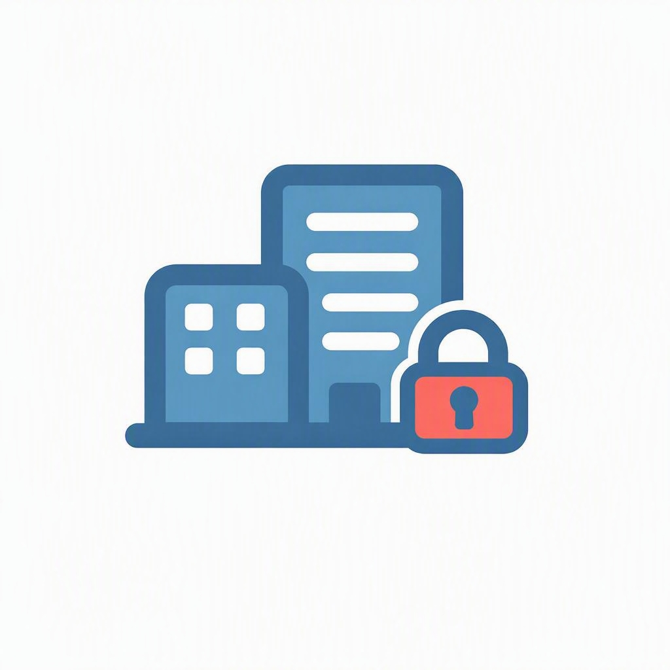
The cloud's built-in advantages
WHY ORGANIZATIONS MOVE TO THE CLOUD
High availability
Scalability
Elasticity
Backed by SLAs and redundancy, so apps stay up even when parts fail.
Add capacity to meet demand, then release it when you no longer need it.
Automatically scale up and down as traffic rises and falls.
Reliability
Security & governance
Manageability
Geo-distributed datacenters keep workloads running through outages.
Built-in controls, policies and compliance certifications.
Run everything through the portal, code and automation.
Predictability Forecast cost and performance as you scale, so you can plan with confidence.
Notes:
Beyond the business drivers, the cloud gives you capabilities that are hard to build yourself. High availability means SLAs and redundancy keep apps up. Scalability and elasticity let you match capacity to demand and scale back automatically. Reliability comes from geo-distributed datacenters. Security and governance are built in with policies and compliance certifications. Manageability means you run everything through the portal, code, and automation. And predictability — the point we added — means you can forecast both cost and performance as you scale. Frame these as the capabilities that on-premises setups struggle to match.
Useful links
Types of cloud computing (Azure): https://azure.microsoft.com/resources/cloud-computing-dictionary/types-of-cloud-computing/

Slide 7
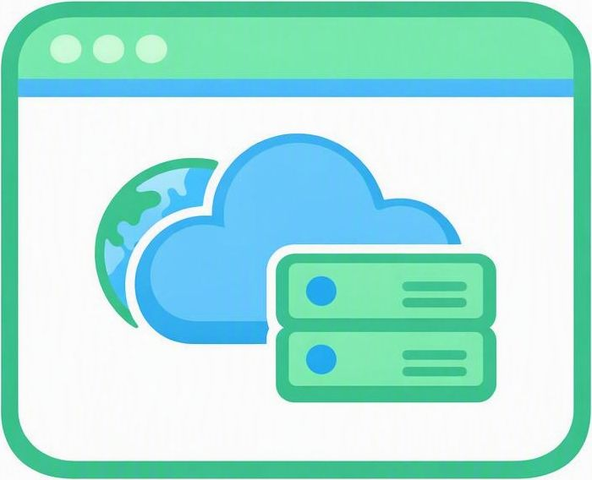
Three ways to consume the cloud
CLOUD SERVICE MODELS
IaaS
PaaS
SaaS
Infrastructure as a Service
Platform as a Service
Software as a Service
You rent raw infrastructure and manage the OS and apps yourself.
You get a ready platform to build on; the provider runs the servers.
Ready-to-use software over the web; the provider manages everything.
e.g. Azure Virtual Machines
e.g. Azure App Service
e.g. Microsoft 365
PIZZA ANALOGY IaaS = take-and-bake · PaaS = pizza delivery · SaaS = dining at the restaurant
Notes:
Three service models sit on a spectrum of control versus convenience. IaaS: you rent raw infrastructure and manage the OS and apps — most control, most work. PaaS: a ready platform to build on, provider runs the servers. SaaS: finished software you just log into. The pizza analogy makes it stick — take-and-bake, delivery, or dining out — you're always eating pizza, you just do less of the work as you move right. The next slide turns this into a concrete stack diagram.
Useful links
Types of cloud computing – IaaS/PaaS/SaaS (Azure): https://azure.microsoft.com/resources/cloud-computing-dictionary/types-of-cloud-computing/

Slide 8
Who secures what?
CLOUD SECURITY BASICS
Microsoft secures
You secure
The cloud itself
What you put in the cloud
Physical datacenters and buildings
Host servers and hardware
The physical network
Datacenter access and security
Your data, always
Identities, accounts and access
Devices and your configuration
How you configure your services
The middle shifts with IaaS you manage the OS and apps; with PaaS the provider takes those on; with SaaS they handle almost everything.
Notes:
This is one of the most important security ideas in the cloud. Microsoft always secures the cloud itself — the physical datacenters, host hardware, and physical network. You always secure what you put in the cloud — your data, identities and accounts, access, and devices. Stress that responsibility for data and identity never shifts to the provider. The middle layer moves with the service model: with IaaS you manage the OS and apps; with PaaS the provider takes those over; with SaaS they handle almost everything. Most cloud incidents come from the customer side — misconfiguration and weak access control — so this matters.
Useful links
Shared responsibility in the cloud (Microsoft Learn): https://learn.microsoft.com/azure/security/fundamentals/shared-responsibility

Slide 9
Who manages what?
CLOUD SERVICE MODELS
You manage
Managed by vendor
Infrastructure
Platform
Software
IaaS — as a service
PaaS — as a service
SaaS — as a service
Applications
Applications
Applications
Runtimes
Runtimes
Runtimes
Security & Integration
Security & Integration
Security & Integration
Databases
Databases
Databases
Servers
Servers
Servers
Virtualization
Virtualization
Virtualization
Server HW
Server HW
Server HW
Storage
Storage
Storage
Networking
Networking
Networking
Same stack, different split the more the provider runs, the less you configure — you trade hands-on control for convenience as you move from IaaS to PaaS to SaaS.
Notes:
This slide makes the service-model split concrete. The same nine-layer stack — from Applications down to Networking — appears under each model; what changes is where the line falls between what you manage (blue) and what the vendor manages (grey). With IaaS you manage the top four layers (applications, runtimes, security & integration, databases) while the vendor runs servers, virtualization, and hardware. With PaaS you manage only your applications. With SaaS the vendor manages the entire stack and you just use the software. The one-line takeaway: the more the provider runs, the less you configure — you trade hands-on control for convenience as you move IaaS → PaaS → SaaS. Tie it straight back to the shared-responsibility slide: your data and identities stay yours in every model.
Useful links
Shared responsibility in the cloud (Microsoft Learn): https://learn.microsoft.com/azure/security/fundamentals/shared-responsibility
Types of cloud computing – IaaS/PaaS/SaaS (Azure): https://azure.microsoft.com/resources/cloud-computing-dictionary/types-of-cloud-computing/

Slide 10
Public, Private & Hybrid Cloud
02
PART 02
Deployment models
Trade-offs
When to use each
Notes:
Now we shift from service models to deployment models — where the cloud actually lives. We'll compare public, private, and hybrid, talk through the trade-offs of each, and then work through scenarios to decide which one fits. Emphasize that most real organizations end up hybrid rather than all-or-nothing.

Slide 11
Public vs private vs hybrid
CLOUD DEPLOYMENT MODELS
Public
Private
Hybrid
Shared infrastructure owned and run by a provider like Azure; you rent capacity over the internet.
Dedicated infrastructure for a single organization — on-premises or hosted.
A connected mix of public and private that work together as one.
Best for: speed, scale, low upfront cost
Best for: strict control & compliance
Best for: flexibility & gradual migration
Notes:
Compare the three deployment models. Public: shared infrastructure run by a provider like Azure — fast, scalable, low upfront cost. Private: dedicated to one organization, on-prem or hosted — maximum control and compliance. Hybrid: a connected mix of both. Stress that public doesn't mean your data is exposed — it's shared hardware but isolated tenancy. Foreshadow that hybrid is where most enterprises actually land.
Useful links
Public, private, and hybrid clouds (Azure): https://azure.microsoft.com/resources/cloud-computing-dictionary/what-are-private-public-hybrid-clouds/

Slide 12
Which model fits the scenario?
CHOOSING A DEPLOYMENT MODEL
A startup launching a web app fast on a tight budget
Public
A bank with strict rules on where data may live
Private
A retailer with steady in-house systems and seasonal spikes
Hybrid
Notes:
Make it concrete with three scenarios — pause and let the class guess before revealing each verdict. The startup on a tight budget wants public for speed and low cost. The bank with strict data-location rules leans private for control and compliance. The retailer with steady in-house systems plus seasonal spikes is a classic hybrid case. The lesson: the right model depends on constraints, not fashion.
Useful links
Public, private, and hybrid clouds (Azure): https://azure.microsoft.com/resources/cloud-computing-dictionary/what-are-private-public-hybrid-clouds/

Slide 13
Inside Azure
03
PART 03
Building blocks
Resource Groups
Regions & Zones
Notes:
This part gets specific to Azure. We'll see how Azure organizes everything into a neat hierarchy, zoom in on resource groups as the everyday container you'll use constantly, and then cover Azure's global footprint — regions and availability zones. This is the structural vocabulary they'll rely on for the rest of the course.

Slide 14
How Azure organizes everything
AZURE ARCHITECTURE BASICS
Subscription
Everything nests neatly
Resource Group
Subscription groups billing and who can access what.
Resources
Resource group keeps all the pieces of one project together.
VMs · Databases · Storage
Resources are the databases, VMs and storage you create.
Notes:
Azure organizes everything into a tidy nesting. Read it from the outside in: a subscription is the billing and access boundary; inside it, resource groups act as folders for related resources; and inside those live the actual resources — VMs, databases, storage. Point out the concentric boxes to reinforce that each layer contains the next. This hierarchy is how you'll find, secure, and bill for everything in Azure — and every action flows through Azure Resource Manager, the control plane behind the portal, CLI, and templates.
Useful links
What is Azure Resource Manager? (Microsoft Learn): https://learn.microsoft.com/azure/azure-resource-manager/management/overview

Slide 15
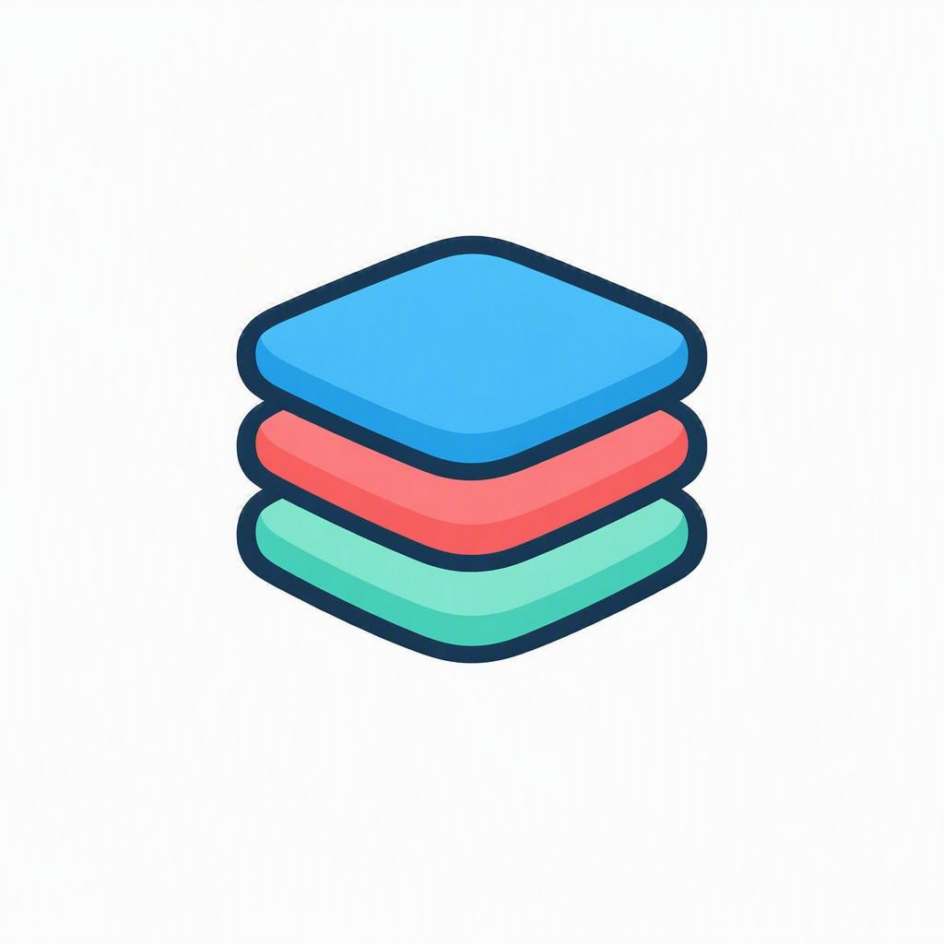
One level up: Management Groups
AZURE ARCHITECTURE BASICS
Above subscriptions
Policies inherit
Up to six levels
A governance layer that sits over many subscriptions at once.
Rules set at the top flow down to every subscription below.
Nest groups to mirror how your teams are organized.
Azure Resource Manager (ARM) is the control plane behind it all — every request from the portal, CLI or templates flows through ARM to create and manage your resources.
Notes:
Zoom out one level above what we just covered. When an organization has many subscriptions, management groups sit on top and let you govern them all together. The full hierarchy is management groups, then subscriptions, then resource groups, then resources. The key idea is inheritance — a policy or access rule set at a management group flows down to every subscription and resource beneath it. You can nest management groups up to six levels deep to mirror how your teams and business units are organized. Small projects may never need them, but they're essential at enterprise scale. Remember that every request — at any level — is carried out by Azure Resource Manager.
Useful links
What are Azure management groups? (Microsoft Learn): https://learn.microsoft.com/azure/governance/management-groups/overview
What is Azure Resource Manager? (Microsoft Learn): https://learn.microsoft.com/azure/azure-resource-manager/management/overview

Slide 16
The folders of Azure
RESOURCE GROUPS
A resource group is a container that holds related Azure resources — like a project folder that keeps everything for one app or environment in one place.
Every resource lives in exactly one group
Group by app, environment or lifecycle
Set access and tags at the group level
Delete the group to remove everything inside
MOVING-DAY ANALOGY
One labeled box per room. When the project ends, move or dispose of the whole box at once.
Notes:
Zoom in on resource groups since they'll use these daily. A resource group is a container for related resources — think project folder. Key rules: every resource lives in exactly one group; you group by app, environment, or lifecycle; and you can set access and tags at the group level. The big one to emphasize: deleting a resource group deletes everything inside it — powerful for cleanup, but handle with care. The moving-box analogy lands well.
Useful links
Manage resource groups in the portal (Microsoft Learn): https://learn.microsoft.com/azure/azure-resource-manager/management/manage-resource-groups-portal

Slide 17
Azure's global footprint
REGIONS & AVAILABILITY ZONES
60+
3+
< 2 ms
Regions worldwide
Zones per region
Latency between zones
One of the largest cloud footprints in the world — and it keeps growing. Figures are approximate as Azure expands.
Notes:
Give a sense of scale: dozens of regions worldwide, at least three availability zones in each enabled region, and very low latency between zones in a region. Be honest that the exact numbers keep changing as Azure expands, so treat them as approximate — the live interactive map below always has the current figures. The takeaway isn't the precise number — it's that Azure has one of the largest global footprints, which is what makes low latency, compliance, and resilience possible.
Useful links
Azure global infrastructure – interactive map: https://datacenters.microsoft.com/globe/explore/
Azure geographies & regions overview: https://azure.microsoft.com/explore/global-infrastructure/geographies/

Slide 18
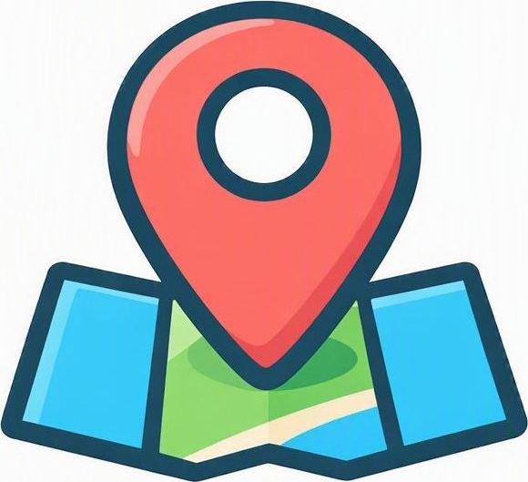
Two words you'll see on day one
REGIONS & AVAILABILITY ZONES
Region
Availability Zone
A geographic area — such as West Europe — where Azure runs datacenters and where you choose to place your resources.
Physically separate datacenters inside a region, each with its own power, cooling and network — so one failing won't take the others down.
You pick a region close to your users or required by rules.
Region
AZ1
AZ2
AZ3
Notes:
Define the two terms they'll meet on day one. A region is a geographic area — like West Europe — where Azure runs datacenters and where you choose to place resources. An availability zone is one of several physically separate datacenters inside a region, each with independent power, cooling, and network. Use the mini diagram: one region contains multiple zones, so if one zone fails, the others keep running. Region = where; zone = which building.
Useful links
What are Azure regions? (Microsoft Learn): https://learn.microsoft.com/azure/reliability/regions-overview
What are Azure availability zones? (Microsoft Learn): https://learn.microsoft.com/azure/reliability/availability-zones-overview

Slide 19
Why the choice matters
REGIONS & AVAILABILITY ZONES
Low latency
Compliance
Resilience
Place resources near your users so apps feel fast and responsive.
Keep data in a specific country to meet legal and data-residency rules.
Spread across zones or regions so an outage in one won't take you offline.
Notes:
Why does the region and zone choice actually matter? Three reasons: low latency (put resources near users so apps feel fast), compliance (keep data in a specific country to meet data-residency laws), and resilience (spread across zones or regions so one outage doesn't take you offline). Tell them this is a real decision they'll make every time they create a resource — it's not just trivia.
Useful links
Choose the right Azure region: https://azure.microsoft.com/explore/global-infrastructure/geographies/
Availability zones – building resilience (Microsoft Learn): https://learn.microsoft.com/azure/reliability/availability-zones-overview

Slide 20
Region pairs & sovereign regions
REGIONS & AVAILABILITY ZONES
Region pairs
Not always paired
Sovereign regions
Many regions link to a partner region in the same geography for geo-replication and disaster recovery.
Many newer regions skip pairing and rely on availability zones for redundancy instead.
Isolated clouds like Azure Government and Azure China (run by 21Vianet) for data-residency rules.
Geo-replication & DR
Zones as backup
Data sovereignty
Notes:
Two more region concepts they will hear about. Region pairs: Azure links many regions to a partner region in the same geography, so data can be replicated for disaster recovery and platform updates roll out one region at a time. Be honest that not every region is paired — many newer regions rely on availability zones for redundancy instead. Sovereign or specialized regions are isolated clouds for strict data-residency and compliance: Azure Government for the U.S. public sector, and Azure China operated locally by 21Vianet. The theme tying it together is data sovereignty — keeping data inside a required legal or geographic boundary.
Useful links
Azure region pairs and nonpaired regions (Microsoft Learn): https://learn.microsoft.com/azure/reliability/regions-paired
Azure for US Government: https://azure.microsoft.com/explore/global-infrastructure/government/
Azure operated by 21Vianet in China (Microsoft Learn): https://learn.microsoft.com/azure/china/overview-operations

Slide 21
Running & Paying for Workloads
04
PART 04
Compute options
Choosing compute
Cloud costs
Notes:
Here we cover two practical questions: where does my code run, and what does it cost? We'll compare the main compute options with a housing analogy, give a quick rule of thumb for choosing, then shift to money — the CapEx-to-OpEx mindset, pricing models, and the tools Azure gives you to keep spend under control.

Slide 22
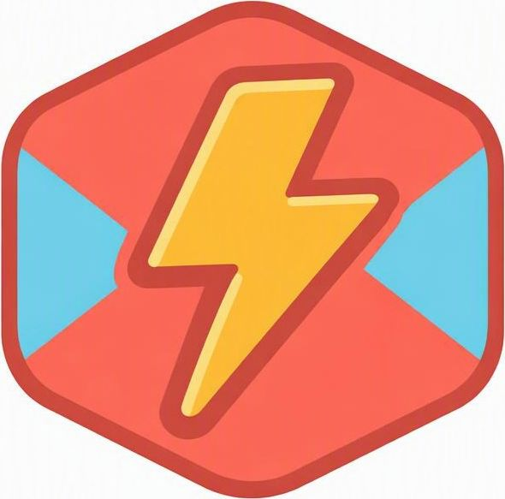
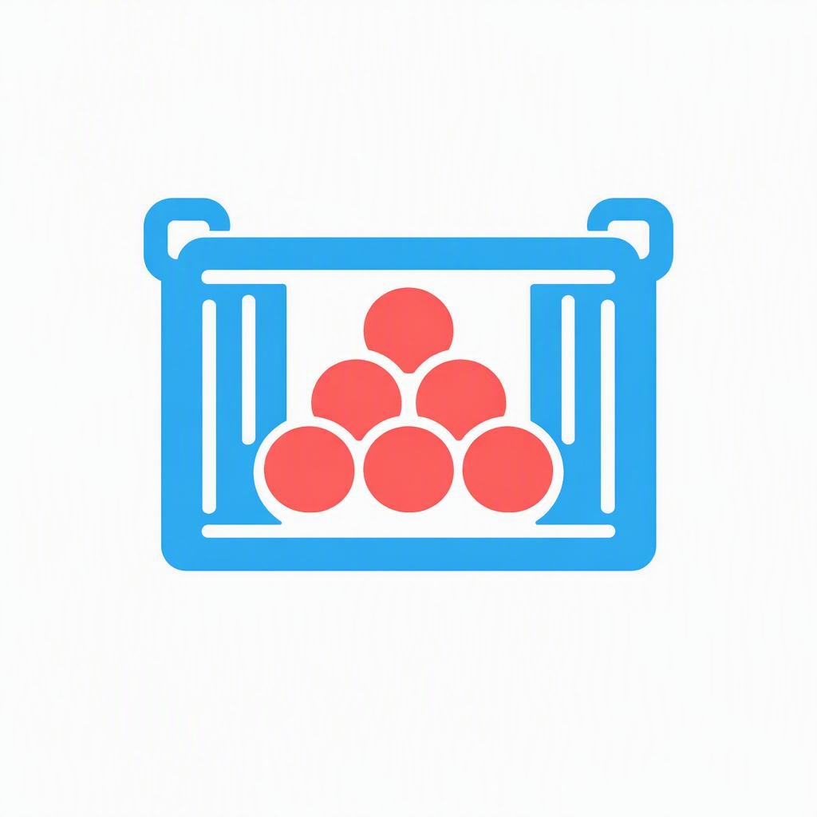
Four ways to run your code
COMPUTE FUNDAMENTALS
Virtual Machines
App Service
Functions
Containers
“Buy a house”
“Rent an apartment”
“Pay per visit”
“Modular home”
Full control of the machine and OS — you patch and maintain it.
Just deploy your web app or API; Azure runs the servers.
Tiny code that runs only when triggered — pay per execution.
Package apps to run anywhere and scale piece by piece.
Notes:
Four ways to run code, framed with a housing analogy. Virtual Machines = buy a house: full control, but you patch and maintain it. App Service = rent an apartment: just deploy your web app, Azure runs the servers. Functions = pay per visit: tiny code that runs only when triggered, billed per execution. Containers = modular home: package once, run anywhere, scale piece by piece. The analogy captures the trade-off between control and how much Azure manages for you.
Useful links
Choose an Azure compute service (Microsoft Learn): https://learn.microsoft.com/azure/architecture/guide/technology-choices/compute-decision-tree

Slide 23
A quick rule of thumb
COMPUTE FUNDAMENTALS
Need full control of the operating system?
→
Virtual Machines
Just hosting a website or API?
→
App Service
Short, event-driven tasks?
→
Azure Functions
Portable microservices that scale?
→
Containers / AKS
Notes:
This is the decision cheat-sheet. Read each question and let them predict the answer. Need full control of the OS? Virtual Machines. Just hosting a website or API? App Service. Short, event-driven tasks? Functions. Portable microservices that scale? Containers or AKS. Reassure them these aren't rigid rules — real projects mix and match — but this rule of thumb covers most everyday choices they'll face.
Useful links
Choose an Azure compute service (Microsoft Learn): https://learn.microsoft.com/azure/architecture/guide/technology-choices/compute-decision-tree

Slide 24
From CapEx to OpEx
CLOUD COST CONCEPTS
CapEx
OpEx
Capital Expenditure · Traditional IT
Operational Expenditure · The cloud way
Big upfront purchase of hardware you own
Plan capacity years in advance
Idle equipment is wasted money
Pay for what you use, billed monthly
No upfront hardware to buy
Scale spending up or down with demand
Bottom line the cloud turns a one-time investment into a flexible, usage-based bill.
Notes:
Introduce the money mindset shift. CapEx — capital expenditure — is the traditional way: a big upfront purchase of hardware you own, planned years ahead, where idle gear is wasted money. OpEx — operational expenditure — is the cloud way: pay for what you use, billed monthly, scaling with demand. Don't get lost in accounting terms; the bottom line is what matters — the cloud turns a one-time investment into a flexible, usage-based bill.

Slide 25
How you pay for compute
CLOUD COST CONCEPTS
Pay-as-you-go
Reserved Instances
Savings Plans
No commitment; pay per second or hour.
Commit to 1 or 3 years for steady workloads.
Commit to an hourly spend across services.
Most flexible
Save up to 72%
Save up to 65%
vs pay-as-you-go
vs pay-as-you-go
Great for spiky or short-term work
Best for predictable, always-on apps
Flexible discount without locking a size
Notes:
Three ways to pay for compute, trading commitment for discount. Pay-as-you-go: no commitment, most flexible, great for spiky or short-term work. Reserved Instances: commit to one or three years and save a lot on steady, always-on workloads. Savings Plans: commit to an hourly spend for flexible discounts without locking to one size. The pattern to teach: the more you commit, the more you save — so match the plan to how predictable the workload is. Savings figures are approximate; the pricing pages below show current rates.
Useful links
Azure Reservations pricing: https://azure.microsoft.com/pricing/offers/reservations/
Azure Savings Plans for compute: https://azure.microsoft.com/pricing/offers/savings-plans/

Slide 26
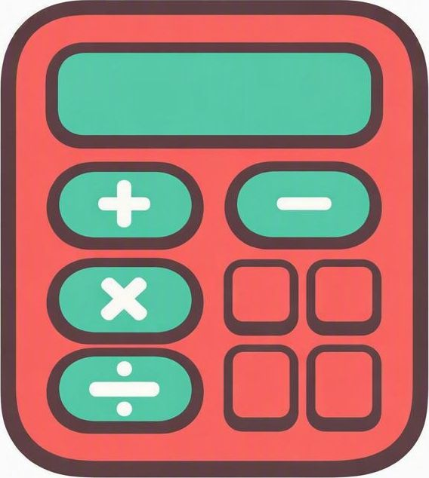

Tools to keep costs in check
CLOUD COST CONCEPTS
Pricing Calculator
Cost Management
Budgets & Alerts
TCO Calculator
Estimate a setup's cost before you build it.
Track spend, spot trends and forecast the month.
Set a limit and get alerted before overspending.
Compare cloud vs. on-premises total cost of ownership.
Tip add tags to resources so you can see exactly which project or team a cost belongs to.
Notes:
Azure gives you tools to stay in control of spend. The Pricing Calculator estimates cost before you build. Cost Management tracks actual spend, shows trends, and forecasts the month. Budgets and Alerts let you set a limit and get notified before you overspend. Close with the tagging tip — tag resources by project or team so you can see exactly where the money goes. Encourage them to set a budget alert on day one of any real project. Heads-up on the TCO Calculator card: Microsoft has retired the standalone TCO Calculator tool, so for a cloud-vs-on-premises comparison use the Pricing Calculator together with an Azure Migrate business case rather than sending students to a dead link.
Useful links
Azure Pricing Calculator: https://azure.microsoft.com/pricing/calculator/
Microsoft Cost Management: https://azure.microsoft.com/products/cost-management/

Slide 27
Hands-On: The Azure Portal
05
PART 05
Where everything lives
Navigation
Key areas
Notes:
Last part is the fun one — the Portal, where all these concepts become real buttons and screens. We'll tour the key areas: search, Home, All Services, resource groups, and Cost Management. If you can, switch to a live browser here and click around; the tour slide is a backup map if the demo isn't available.

Slide 28
A quick tour of the Portal
AZURE PORTAL NAVIGATION
Global search
Home & Dashboard
All services
Jump straight to any service or resource by name.
Recent items, quick-create and pinned tiles.
Browse the full catalog from the left menu.
Resource groups
Cost Management
Cloud Shell
See everything that belongs to one project.
Track spend and budgets in real time.
Run commands right inside the browser.
Notes:
This is your map of the Portal — ideally switch to a live browser and click through it. Hit the six landmarks: global search to jump to any service, Home and Dashboard for recent and pinned items, All Services to browse the full catalog, Resource Groups to see one project's pieces together, Cost Management for spend, and Cloud Shell to run commands right in the browser. Tell them the Portal feels big at first but you really only use a handful of these areas daily.
Useful links
Azure Portal (sign in): https://portal.azure.com
About the Azure Portal: https://azure.microsoft.com/get-started/azure-portal/

Slide 29

Test yourself
?
QUICK QUIZ
Six quick questions to sum up Week 1 — we'll review the answers together at the end.
Notes:
Time to check understanding. Tell the class these six questions recap the whole week — they can call out answers or jot them down, and we'll review together on the answer-key slide. Keep it light and encouraging.

Slide 30
Questions 1 & 2
QUICK QUIZ
Q1
What best describes cloud computing?
A Owning your own servers
B Renting computing, pay per use
C A programming language
D A kind of database
Q2
Which model links on-premises and public cloud?
A Public
B Private
C Hybrid
D Multi-cloud
Notes:
Q1 tests the core definition — the answer is B, renting computing and paying for what you use. Q2 is C, hybrid, which connects private and public cloud so they work together. Let the class answer before you confirm.

Slide 31
Questions 3 & 4
QUICK QUIZ
Q3
A resource group is essentially...
A A billing account
B A folder for related resources
C A virtual machine
D A datacenter
Q4
Availability Zones mainly provide...
A Cheaper storage
B Faster code
C Resilience via separate datacenters
D More regions
Notes:
Q3 is B — a resource group is a folder that keeps related resources together. Q4 is C — zones are physically separate datacenters so an outage in one doesn't take you down. Reinforce the folder and resilience mental models.

Slide 32
Questions 5 & 6
QUICK QUIZ
Q5
Which runs only when triggered, billed per run?
A Virtual Machines
B App Service
C Containers
D Azure Functions
Q6
Reserved Instances mainly give you...
A More flexibility
B Lower cost for steady workloads
C No commitment
D Unlimited scale
Notes:
Q5 is D — Azure Functions are event-driven and billed per execution. Q6 is B — reserving capacity for 1 or 3 years lowers cost for predictable, always-on workloads. Tie back to the compute and cost sections.

Slide 33
Answer key
QUICK QUIZ
B
Q1 · correct answer B
C
Q2 · correct answer C
Cloud is rented computing — you pay for what you use.
Hybrid connects private and public cloud.
B
Q3 · correct answer B
C
Q4 · correct answer C
A resource group groups related resources, like a folder.
Separate datacenters keep you running through an outage.
D
Q5 · correct answer D
B
Q6 · correct answer B
Functions are event-driven and billed per execution.
Commitment lowers cost for predictable workloads.
Notes:
Walk through each answer and restate the underlying concept in one line. Celebrate the progress — if they can answer most of these, they've got the Week 1 foundations down and are ready for hands-on work next week.

Slide 34
WEEK 1 WRAP-UP
Key takeaways
The cloud lets you rent computing on demand and pay for what you use.
Public, private and hybrid each suit different needs and rules.
Azure nests everything: subscriptions → resource groups → resources, across global regions and zones.
Match compute to the job, then control costs with the right pricing model and tools.
NEXT WEEK
Hands-on: create your first resources in the Azure Portal.
Notes:
Wrap up with the four big ideas: the cloud is rent-and-pay-per-use computing; public, private, and hybrid each fit different needs; Azure nests everything from subscriptions to resource groups to resources across global regions and zones; and you match compute to the job, then control costs with the right pricing model and tools. Tease next week — hands-on creating their first resources in the Portal. Encourage them to sign up for a free Azure account so they can follow along live, and to skim the AZ-900 study guide if they're aiming at the certification.
Useful links
Create a free Azure account: https://azure.microsoft.com/free/
AZ-900 study guide: https://learn.microsoft.com/credentials/certifications/resources/study-guides/az-900
Azure Fundamentals certification: https://learn.microsoft.com/credentials/certifications/azure-fundamentals/

